Slide 1

Stacks: Stack ADT, Stack Operations: Push & Pop
Data Structure | Introduction to Data Structure
Course: Data Structure | Chapter: Introduction to Data Structure | Program: Bachelor of Engineering | Institution: Chandigarh University
DISCOVER · LEARN · EMPOWER
Notes:
Welcome everyone to today's lecture on Stacks. We are diving into the fundamental concepts of the Stack ADT and its core operations. This session is designed to build your foundational understanding for solving complex problems later. Remember, mastering these basics is key to your success in Data Structures.

Slide 2
Course Outcomes
SLIDE 2 / 10
Course Outcome
CO | BT LEVEL | DESCRIPTION
CO1 | BT1 | Understand and apply basic data structures, algorithms, complexity analysis, ADTs, arrays and linked lists.
CO2 | BT2 | Apply and implement stacks and queues in problem-solving.
CO3 | BT3 | Analyse and apply searching, sorting, and hashing techniques.
CO4 | BT4 | Construct and apply tree structures and traversal techniques.
CO5 | BT5 | Represent and solve graph problems using DFS, BFS, and graph algorithms.
Chandigarh University
2 / 10
Notes:
Today's lecture directly supports our Course Outcomes. You will learn to apply stack operations to solve problems as required by CO2. Additionally, understanding linear structures like stacks prepares you for the tree structures mentioned in CO4. These outcomes ensure you can construct and apply these techniques effectively.

Slide 3
Learning Objectives
SLIDE 3 / 10
Learning Outcomes
1
Define the Stack Abstract Data Type and its Last-In-First-Out property.
2
Identify the two primary operations: Push to add and Pop to remove elements.
3
Explain the concept of Stack Overflow and Stack Underflow conditions.
4
Demonstrate the sequence of operations using a visual stack representation.
5
Differentiate between the logical ADT and its physical array implementation.
Chandigarh University
3 / 10
Notes:
By the end of this session, you will be able to define the Stack ADT clearly. You will understand exactly how Push and Pop work in a real-world scenario. We will also cover the critical error conditions you must handle in your code. Finally, you will see how these logical concepts map to physical memory.

Slide 4
Lecture
SLIDE 4 / 10
Stack ADT Definition and LIFO
1
A Stack is a linear data structure following the Last-In-First-Out principle.
2
The most recently added element is the first one to be removed.
3
Access is restricted to one end called the Top of the Stack.
4
Elements are inserted and removed sequentially from the same end point.
5
Common real-world analogy includes a stack of plates in a cafeteria.
Chandigarh University
4 / 10
Notes:
Think of a stack of plates in a cafeteria. You can only add a new plate on top or remove the top one. You cannot take a plate from the middle. This is the essence of the Last-In-First-Out principle. In our data structure, the 'Top' pointer tracks the current topmost element.

Slide 5
Push Operation
SLIDE 5 / 10
Adding Elements
1
The Push operation adds a new element to the top of the stack.
2
First, check if the stack is full to prevent Stack Overflow errors.
3
Increment the Top pointer to point to the new available position.
4
Store the new data value at the location indicated by the Top pointer.
5
The operation time complexity is O(1) for constant time execution.
Chandigarh University
5 / 10
Notes:
When we push an element, we first check if there is space. If the stack is full, we cannot add more. We then move our Top pointer up and place the new data there. For example, if we push the number 10, it becomes the new top. This operation is very fast and takes constant time.

Slide 6
Pop Operation
SLIDE 6 / 10
Removing Elements
1
The Pop operation removes the most recently added element from the top.
2
First, check if the stack is empty to prevent Stack Underflow errors.
3
Retrieve the data value currently stored at the Top pointer location.
4
Decrement the Top pointer to point to the previous element below.
5
The operation time complexity is O(1) for constant time execution.
Chandigarh University
6 / 10
Notes:
The Pop operation is the reverse of Push. We remove the top element and return its value. Before doing this, we must ensure the stack is not empty. If we try to pop from an empty stack, we get an underflow error. After removal, the pointer moves down to the next element.

Slide 7
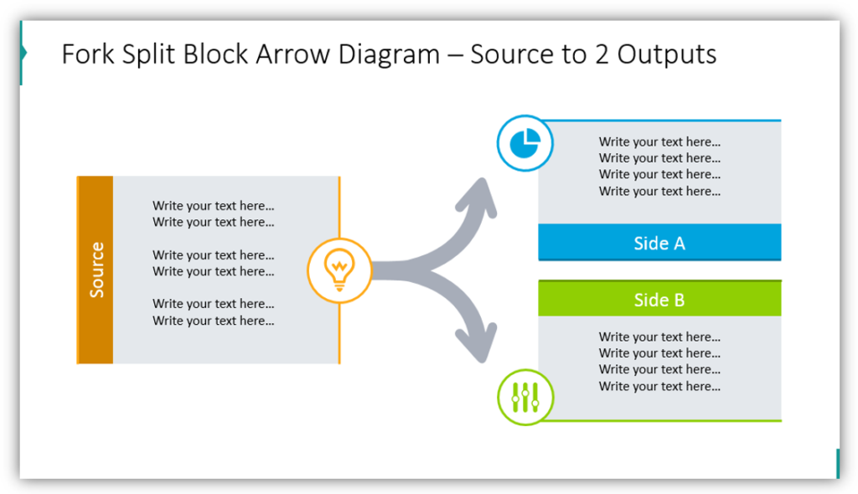
Lecture
SLIDE 7 / 10
Stack Overflow and Underflow
1
Stack Overflow occurs when attempting to Push onto a full stack.
2
Stack Underflow occurs when attempting to Pop from an empty stack.
3
Both conditions represent critical errors that must be handled in code.
4
Overflow prevents data loss by rejecting new elements when capacity is reached.
5
Underflow prevents invalid access by checking for zero elements before removal.
Source: blog.infodiagram.com
Chandigarh University
7 / 10
Notes:
These are the two main error conditions you must handle. Overflow happens when you try to add to a full stack. Underflow happens when you try to remove from an empty one. In C programming, you must write conditional checks to prevent these crashes. Always validate the stack state before any operation.

Slide 8
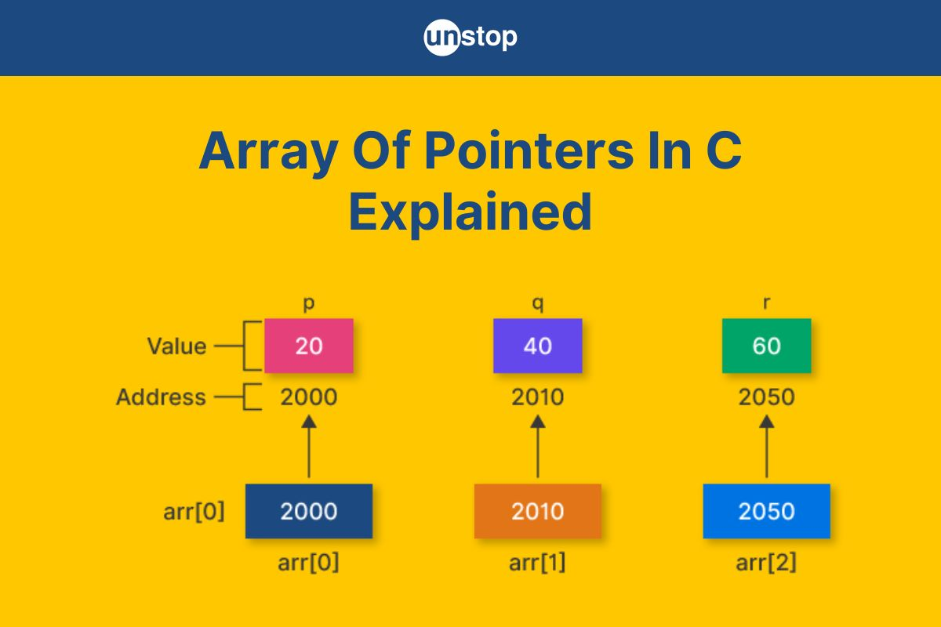
Worked Example
SLIDE 8 / 10
Push and Pop Sequence
GOVERNING EQUATION
Initial State: Stack is empty, Top = -1
POP
Returns 30, Top becomes 1, Stack now holds [10, 20].
• Push 10: Top becomes 0, Array[0] = 10.
• Push 20: Top becomes 1, Array[1] = 20.
• Push 30: Top becomes 2, Array[2] = 30.
Source: d8it4huxumps7.cloudfront.net
Chandigarh University
8 / 10
Notes:
Let's trace a sequence. We start empty. Pushing 10 puts it at index 0. Pushing 20 puts it at index 1. Pushing 30 puts it at index 2. Now, if we Pop, we get 30 back. The Top pointer moves back to index 1. The stack now effectively contains 10 and 20.

Slide 9

Lecture
SLIDE 9 / 10
Key Takeaways
1
Stacks follow the Last-In-First-Out (LIFO) access pattern strictly.
2
Push adds to the top; Pop removes from the top only.
3
Always check for Overflow before Push and Underflow before Pop.
4
Both operations have O(1) time complexity for efficient performance.
5
The Top pointer is crucial for tracking the current stack state.
Source: content.twinkl.co.uk
Chandigarh University
9 / 10
Notes:
To summarize, remember the LIFO principle is the core of stacks. Push and Pop are the only ways to interact with the data. Always check for errors to ensure your program runs safely. These operations are fast and efficient. Keep the Top pointer logic in mind for all implementations.

Slide 10
Lecture
SLIDE 10 / 10
References
DATA STRUCTURES
A Pseudocode Approach with C — Gilberg, Forouzan
• Data Structures — Lipschutz
• Data Structure Using C — AK Sharma
• C and Data structure — P. S. Deshpandey
Chandigarh University
10 / 10
Notes:
These are the standard reference books for this course. I recommend Gilberg and Forouzan for a pseudocode approach. Lipschutz provides excellent theoretical foundations. Sharma and Deshpandey offer great C-specific implementations. Please refer to these texts for further practice and deeper understanding.

